Slide 1
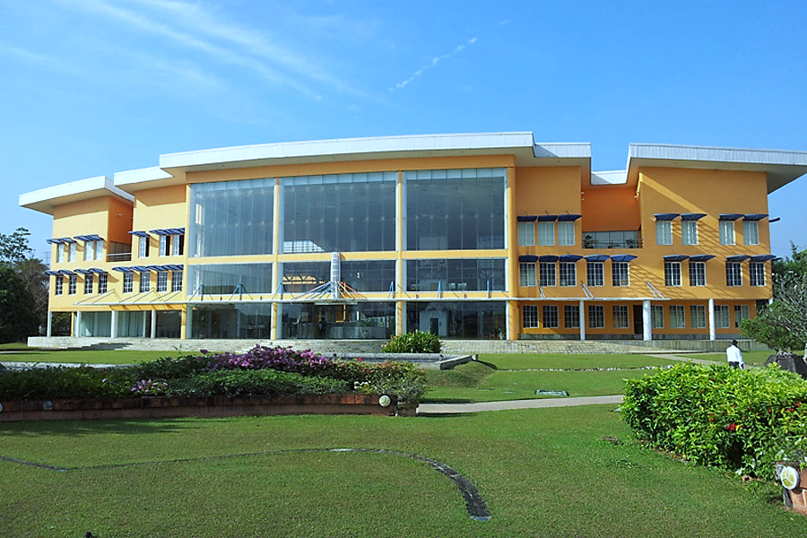
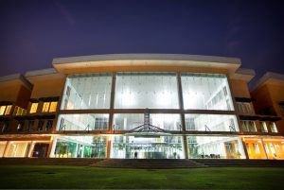




HEADLINES
01
About Myself
02
Favorite Superhero
03
About LSEG
04
Capital Markets
05
About ITIL
06
Application Support Engineer
07
Why I want to work as an Application Support Engineer
JANITH GAYASHAN GEDAWATTA
LSEG Technology
071 037 59 41
Application Services
gedarawatta.j@gmail.com

Slide 2

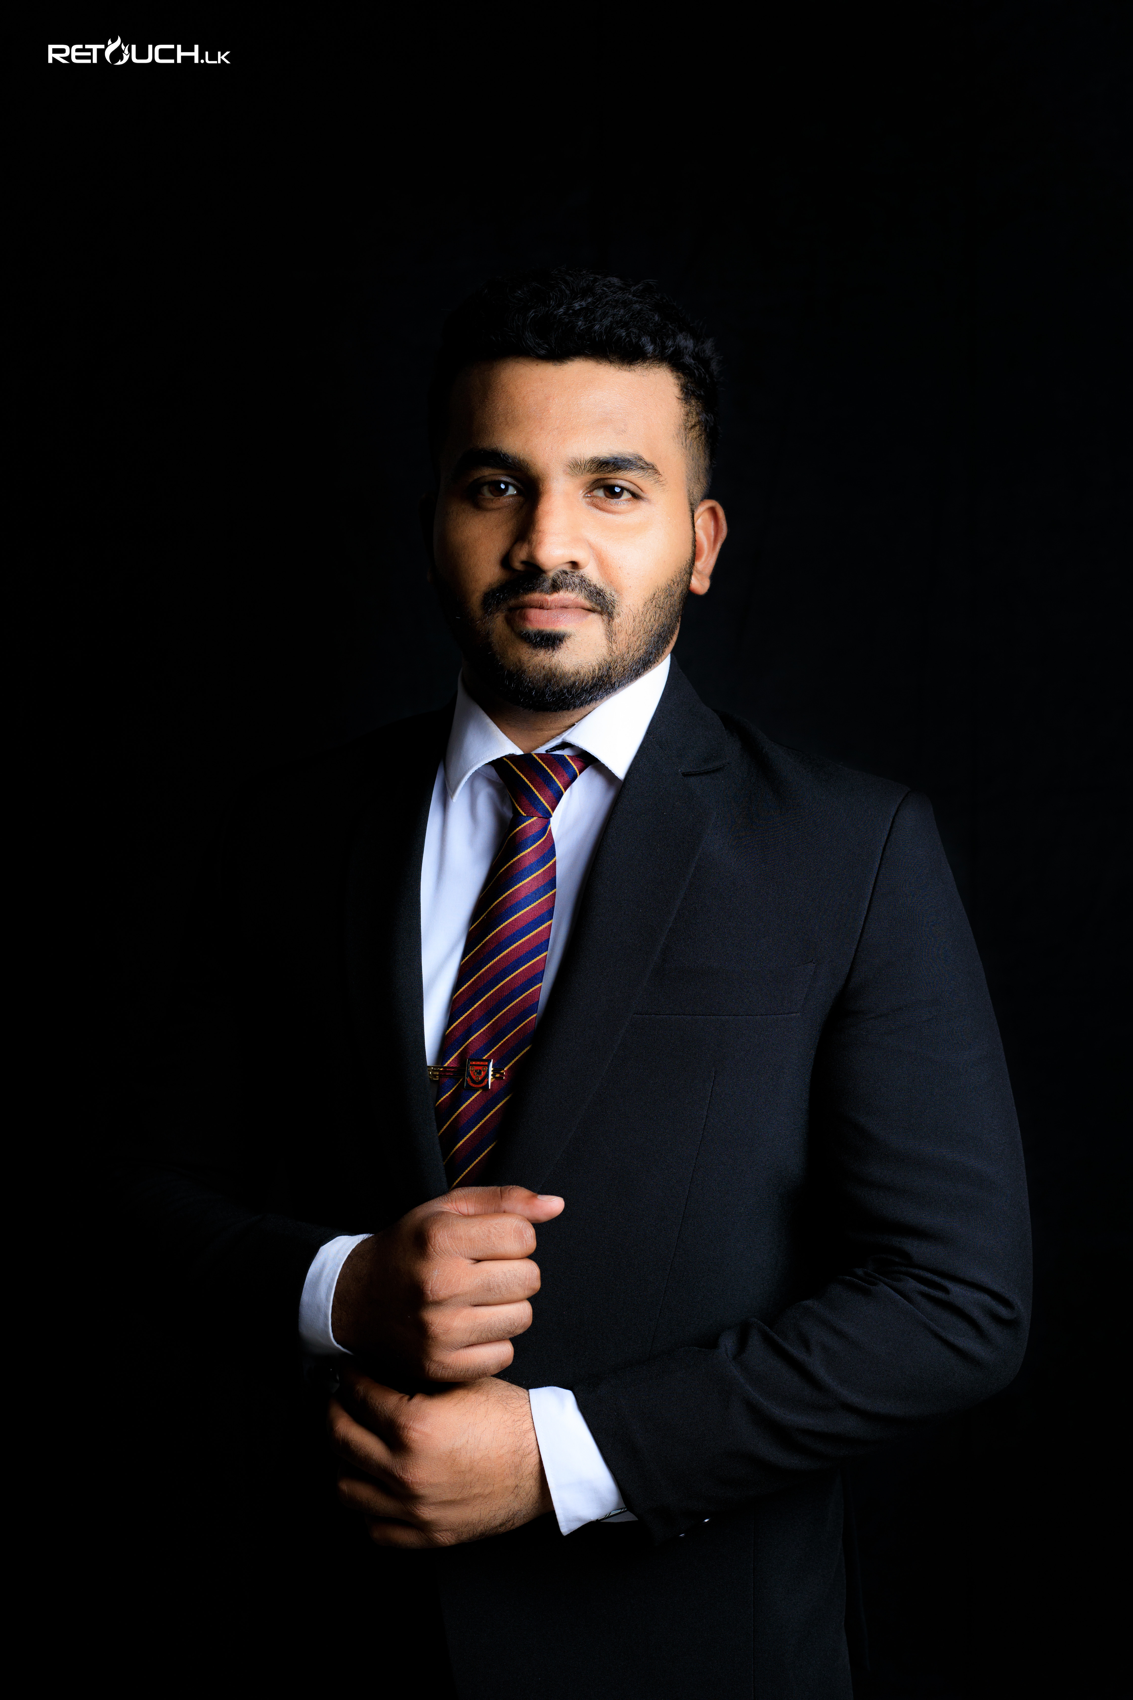
Who Am I?
Name – Janith Gedarawatta
Lives in Kurunegala
Graduated from SLIIT
Charter President of Rotaract Club of Athugalpura
3+ years experience as an Associate System Support Engineer at MillenniumIT ESP
A hard working, dedicated person
Good Team worker
Good communication skills
Good skills at problem solving
Excellent at managing work and people

Slide 3

Who needs a superhero when you have your parents ?

Slide 4




ABOUT LSEG
Main Market
London Stock Exchange’s Main Market is the world’s most international market for the admission and trading of equity, debt and other securities. It includes Over 1,300 companies from 70 countries.
History
London Stock Exchange is one of the world’s oldest stock exchanges and can trace its history back more than 300 years. London Stock Exchange Group was created in October 2007 when London Stock Exchange merged with Milan Stock Exchange, Borsa Italiana.
04
03
What is LSEG Technology ?
LSEG Technology is a part of the Global Technology Services. It provides capital market technologies & services.
What is LSEG ?
02
London Stock Exchange Group is a British-based stock exchange and financial information company. It is headquartered in London, England..
01

Slide 5



Capital markets
Capital markets refer to the places where savings and investments are moved between suppliers of capital and those who are in need of capital.
Capital markets consist of the primary market, where new securities are issued and sold, and the secondary market, where already-issued securities are traded between investors.
The most common capital markets are the stock market and the bond market.

Slide 6

04
Utilized by some of the most high-profile organizations in the world
03
ITIL Practitioner is an expert in continually shaping IT service development processes.
It is designed to help businesses manage risks, strengthen customer relations, establish cost-effective practices and build stable IT environments for growth, scale and change.
02
The ‘Information Technology Infrastructure Library’ is a set of best practices for creating and improving an ITSM process.
01
ITIL

Slide 7





IMPORTANCE OF AN APPLICATION SUPPORT ENGINEER
C
Application Support Engineers oversee the installation and maintenance of software applications in order to streamline business operations.
Should have the required technical knowledge to handle issues and situations
Should have the skill of solving problems under critical situations as quickly as possible
Their duties include optimizing software application performance, installing updates, and performing debugging procedures.
Whole business and operation depends on an Application Support Engineer

Slide 8

I have a skill to manage people. I’d like to lead my career to a manager / technical lead level one day
I am excided to work in a reputable company like LSEG
WHY WE WORK
I want to explore more
I want to expand my knowledge
I have a skill of solving issues quickly under critical environments
I like to work with a team

Slide 9




THANK YOU

